Slide 1
The Sickle Cell Disease Newborn Screening Follow up Program (SCDNBFP) Request for Proposal
September 18, 2020

Slide 2
Agenda
Introductions
Overview of RFP
Eligibility
Program Requirements
Application and Submission Information
Application Review Information
Frequently Asked Questions
Questions

Slide 3
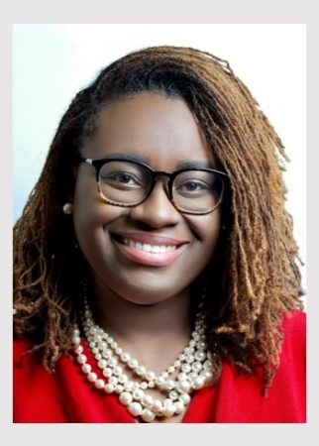
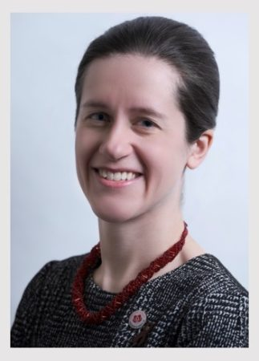
Introductions
Ashley Clark, Project Director
Arielle Juberg, Program Manager

Slide 4
Overview of RFP
Goal: The goal of this program is to ensure that individuals diagnosed with SCD receive appropriate follow-up services including counseling, education, access to a medical home, and other services by supporting CBOs focused on SCD.
Award: Four awards are available; each award is $25,000. Funds must be spent by May 31, 2021.
Duration: CBOs selected through this funding opportunity will begin November 1, 2020. Funds must be spent by May 31, 2021. Program data should be reported to SCDAA by July 5, 2021.
Please refer to RFP posted on SCDAA website for full details

Slide 5
Eligibility
A Sickle Cell CBO is a 501 (c) (3) non-medical community-based organization or a 501c3 nonprofit organization whose primary purpose is serving individuals with SCD and their families through providing direct, support, and advocacy services.
A Community Health Worker (CHW) is a lay health worker who is a trusted member of the community they serve and often belongs to the community served.
Please see Pg. 3 in RFP and “CBO Standards” for full eligibility requirements for CBOs

Slide 6
Program Requirements
Activities fall into 6 categories:
Patient Recruitment & Assessment
Utilization of Community Health Workers and Educator Counselors
Community Based Services and Care Coordination
Education and Dissemination
Partnership Building*
Data Collection
Activities listed on Pgs. 3-5 of RFP

Slide 7
Application and Submission Information
The due date for applications under this RFP is October 9, 2020 at 11:59 P.M. Eastern Standard Time. Applications submitted after this deadline will not be considered.
Each completed application should be emailed to Ashley Clark at aclark@sicklecelldisease.org with four document attachments. These attachments should be titled: Narrative, Budget, Work Plan, and Attachments.

Slide 8
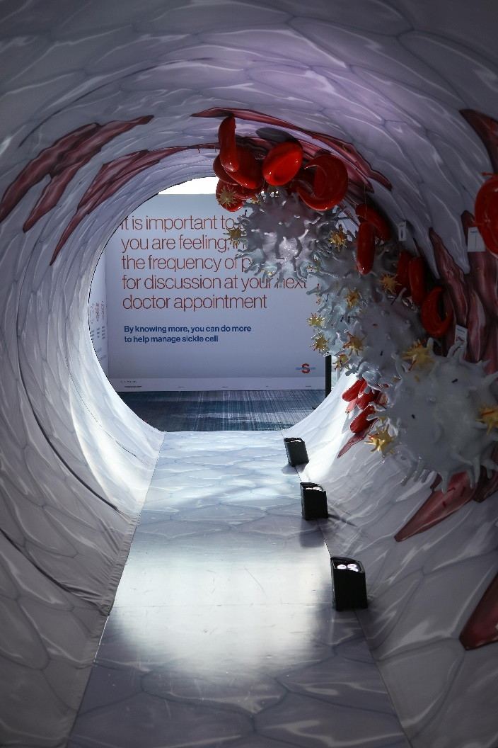
Application and Submission Information
Narrative should include:
Project Abstract
Needs Assessment
Organizational Information
Methodology
Data Collection Capacity
Resolution of Challenges
Sustainability Plan

Slide 9
Application and Submission Information
Budget:
Please use the SCDAA budget template that was shared with this RFP. The project budget should include the total allowable costs (inclusive of direct and indirect costs) incurred by the recipient to carry out this project or activity from November 1, 2020 to May 31, 2021. Include sufficient detail in this budget so that SCDAA can understand the expense.
Please refer to the “Budget Guidance” document for guidelines and restrictions

Slide 10
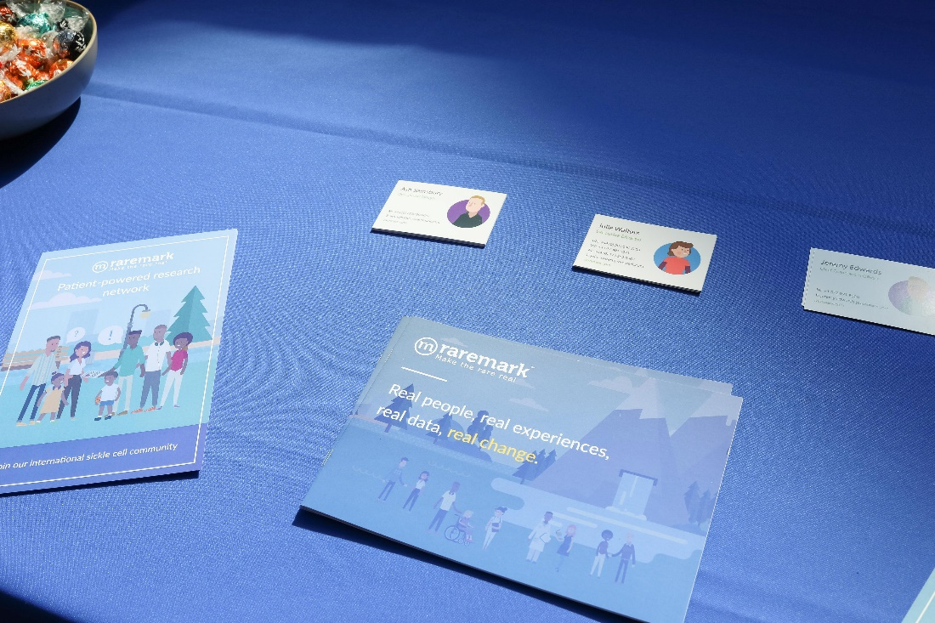
Application and Submission Information
Budget sections include:
Personnel
Fringe
Travel
Supplies
Printing
Event Room Rental
Program Incentives
Training & Recruitment
Other
Sub-Contractors
Indirect Expenses

Slide 11
Application and Submission Information
Work Plan:
Use the SCDAA work plan template to outline the activities you will undertake to meet the stated objectives. Each of the program requirements listed above is included in the work plan. For each requirement, list between 1 to 4 activities that will be undertaken.
In addition to the activities, please include a SMART objective for each of the 6 topic areas. A SMART objective is Specific, Measurable, Achievable, Realistic, and Time-phased.
Additional information is provided in the “Instructions” tab of the work plan template.

Slide 12
Application and Submission Information

Slide 13
Application and Submission Information
Attachment 1: Staffing Plan
Include the role, responsibilities, and qualifications of proposed project staff.
Attachment 2: Project Organizational Chart
Provide a one-page figure that depicts the organizational structure of the project.
Other Relevant Documents
Include any relevant documents, including letters of support.

Slide 14
Application and Submission Information
Font: Please use an easily readable font, such as Times Roman, Arial, Courier, or CG Times. The text and table portions of the application must be single-spaced and submitted in 12-point font.
Paper Size and Margins: For duplication and scanning purposes, ensure that the application can be printed on 8½” x 11” white paper. Margins must be at least one inch at the top, bottom, left and right of the paper. Left-align text.
Page Limit: Completed applications shall be no more than 15 pages. Applications can be fewer than 15 pages. The Budget, Work Plan, and Attachments will not be counted in this limit.
Please see Pgs. 8-10 in RFP for complete formatting information

Slide 15
Application and Submission Information
Document Title | Include in designated file | Count in 15-page limit | Must be numbered
Abstract | Narrative | Yes | No
Narrative | Narrative | Yes | Yes
Budget | Budget | No | No
Work Plan | Work Plan | No | No
Attachments | Attachments | No | Yes

Slide 16
Application Review Information
Applications will be scored according to the following criteria:
Clarity of plan (0-5 points)
Demonstrated need (0-10 points)
Data Collection Capacity (0-10 points)
Work Plan (0-10 points)
Budget (0-5 points)
Potential impact (0-5 points)
Innovative Approach (0-5 points)
The four applicants with the highest cumulative scores will be awarded funds.

Slide 17
Frequently Asked Questions
Q: What is the schedule for reviewing applications?
A: Applications must be submitted by October 9, 2020. SCDAA will review applications based on the criteria above and decide by the week of October 25. Funding will begin on November 1, 2020. Newly-funded CBOs who are selected should plan to have onboarding calls and webinars the week of November 1, 2020.
Q: If I am already funded as part of the SCD Newborn Screening Follow-Up Program, can I apply for additional funding?
A: Yes. Current sub-grantees can apply to be considered for additional funding. Please refer to specific instructions for current sub-grantees in the Application and Submission Information section.

Slide 18
Frequently Asked Questions
Q: Do I need to be an SCDAA member organizations?
A: No, CBOs are not required to be an SCDAA member organization.
Q: How will CBOs receive funding?
A: Funding is provided on a reimbursement basis. CBOs will spend funds on allowable costs and be reimbursed by the 15th of the following month. Receiving reimbursement is contingent on submitting documentation of expenses each month.

Slide 19
Frequently Asked Questions
Q: What will happen after federal funding ends?
A: This federal grant will continue until May 31, 2021. A new iteration of the Sickle Cell Disease Newborn Screening Follow-Up Program was recently announced by the Health Resources and Services Administration (HRSA). The funding forecast is available here:
https://www.grants.gov/web/grants/view-opportunity.html?oppId=328460
SCDAA does not have any more information than what is included in the forecast.
SCDAA has been sharing resources to assist CBOs in sustaining successful grant activities. Newly-funded CBOs would also receive these resources.

Slide 20
Questions
Q & A will be recorded and posted to the SCDAA website

